Slide 1
Text Representation

Slide 2
How do we represent a document?
How to represent a document?
Make it computable
How to infer the relationship among documents or identify the structure within a document?
Knowledge discovery
‹#›

Slide 3
How do we represent the meaning of a word?
Represent documents by concept vectors
Each concept defines one dimension
k concepts define a high-dimensional space
Element of vector corresponds to concept weight
E.g., d=(x1,…,xk), xi is “importance” of concept i in d
Distance between the vectors in this concept space
Relationship among documents
‹#›

Slide 4
Bag-of-Words representation
Term as the basis for vector space
Doc1: Text mining is to identify useful information.
Doc2: Useful information is mined from text.
Doc3: Apple is delicious.
 | text | information | identify | mining | mined | is | useful | to | from | apple | delicious
Doc1 | 1 | 1 | 1 | 1 | 0 | 1 | 1 | 1 | 0 | 0 | 0
Doc2 | 1 | 1 | 0 | 0 | 1 | 1 | 1 | 0 | 1 | 0 | 0
Doc3 | 0 | 0 | 0 | 0 | 0 | 1 | 0 | 0 | 0 | 1 | 1
‹#›

Slide 5
Bag-of-Words representation
Assumption
Words are independent from each other
Pros
Simple
Cons
Basis vectors are clearly not linearly independent!
Grammar and order are missing
 | text | information | identify | mining | mined | is | useful | to | from | apple | delicious
Doc1 | 1 | 1 | 1 | 1 | 0 | 1 | 1 | 1 | 0 | 0 | 0
Doc2 | 1 | 1 | 0 | 0 | 1 | 1 | 1 | 0 | 1 | 0 | 0
Doc3 | 0 | 0 | 0 | 0 | 0 | 1 | 0 | 0 | 0 | 1 | 1
‹#›

Slide 6
How to assign weights?
Important!
Why?
Corpus-wise: some terms carry more information about the document content
Document-wise: not all terms are equally important
How?
Two basic heuristics
TF (Term Frequency) = Within-doc-frequency
IDF (Inverse Document Frequency)
‹#›

Slide 7
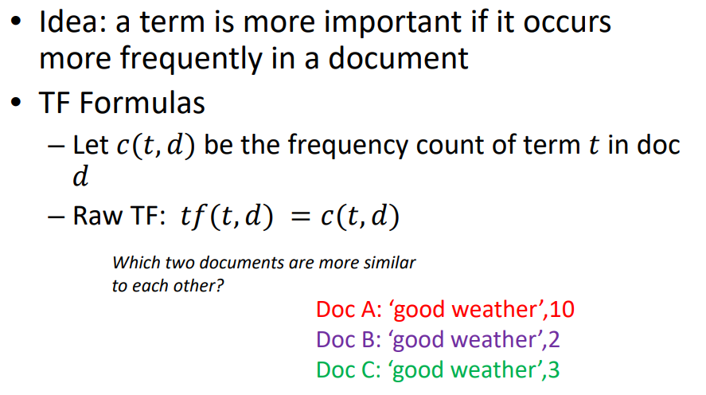
Term Frequency
‹#›

Slide 8
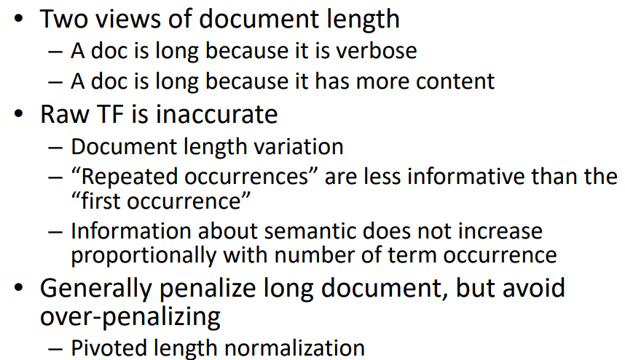
TF Normalization
‹#›

Slide 9
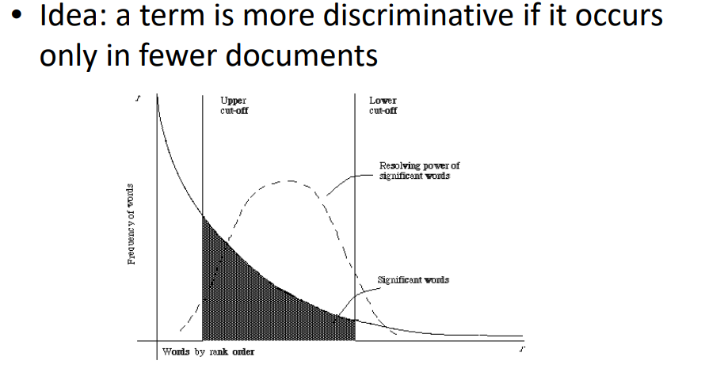
Document Frequency
‹#›

Slide 10
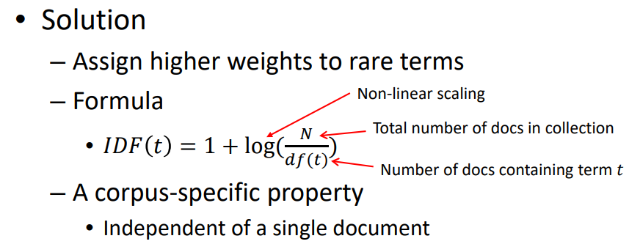
Inverse document frequency
‹#›

Slide 11
TF Normalization
‹#›

Slide 12
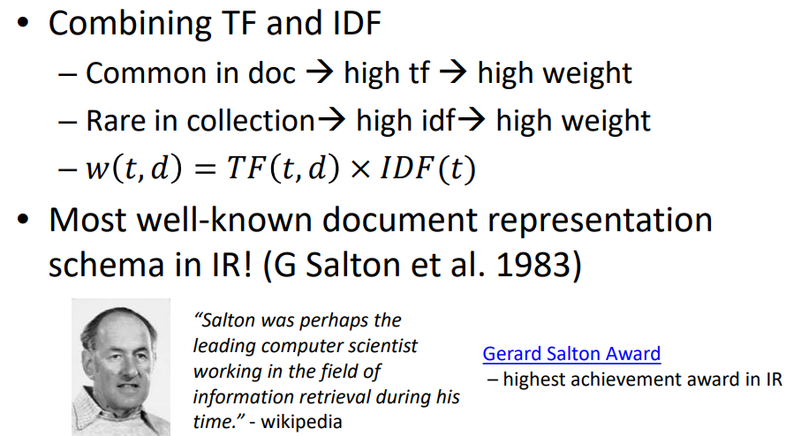
TF-IDF weighting
‹#›

Slide 13
How do we represent the meaning of a word?
Definition: meaning (Webster dictionary)
the idea that is represented by a word, phrase, etc.
the idea that a person wants to express by using words, signs, etc.
the idea that is expressed in a work of writing, art, etc.
Commonest linguistic way of thinking of meaning:
signifier (symbol) ⟺ signified (idea or thing)
= denotational semantics
tree ⟺ {🌳, 🌲, 🌴, …}
‹#›

Slide 14
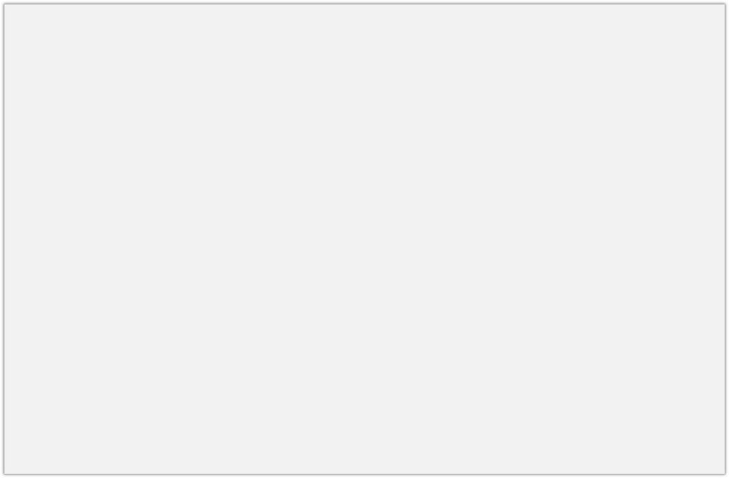
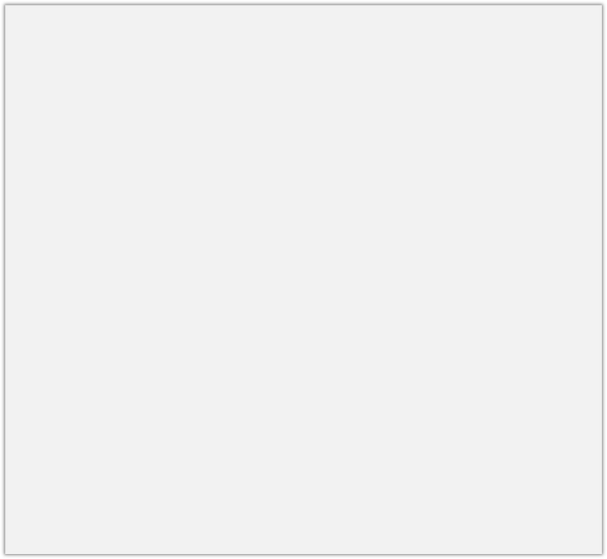
How do we have usable meaning in a computer?
Previously commonest NLP solution: Use, e.g., WordNet, a thesaurus containing lists of
synonym sets and hypernyms (“is a” relationships)
e.g., synonym sets containing “good”: e.g., hypernyms of “panda”:
from nltk.corpus import wordnet as wn
poses = { 'n':'noun', 'v':'verb', 's':'adj (s)', 'a':'adj', 'r':'adv'} for synset in wn.synsets("good"):
print("{}: {}".format(poses[synset.pos()],
", ".join([l.name() for l in synset.lemmas()])))
from nltk.corpus import wordnet as wn panda = wn.synset("panda.n.01")
hyper = lambda s: s.hypernyms() list(panda.closure(hyper))
noun: good
noun: good, goodness noun: good, goodness
noun: commodity, trade_good, good adj: good
adj (sat): full, good adj: good
adj (sat): estimable, good, honorable, respectable
adj (sat): beneficial, good adj (sat): good
adj (sat): good, just, upright
…
adverb: well, good
adverb: thoroughly, soundly, good
[Synset('procyonid.n.01'), Synset('carnivore.n.01'), Synset('placental.n.01'), Synset('mammal.n.01'), Synset('vertebrate.n.01'), Synset('chordate.n.01'), Synset('animal.n.01'), Synset('organism.n.01'), Synset('living_thing.n.01'), Synset('whole.n.02'),
Synset('object.n.01'), Synset('physical_entity.n.01'), Synset('entity.n.01')]
‹#›

Slide 15
Problems with resources like WordNet
A useful resource but missing nuance:
e.g., “proficient” is listed as a synonym for “good”
This is only correct in some contexts
Also, WordNet list offensive synonyms in some synonym sets without any coverage of the connotations or appropriateness of words
Missing new meanings of words:
e.g., wicked, badass, nifty, wizard, genius, ninja, bombest
Impossible to keep up-to-date!
Subjective
Requires human labor to create and adapt
Can’t be used to accurately compute word similarity (see following slides)
‹#›

Slide 16
Representing words as discrete symbols
In traditional NLP, we regard words as discrete symbols:
hotel, conference, motel – a localist representation
Means one 1, the rest 0s
Such symbols for words can be represented by one-hot vectors:
Motel = [0 0 0 0 0 0 0 0 0 0 1 0 0 0 0]
hotel = [0 0 0 0 0 0 0 1 0 0 0 0 0 0 0]
Vector dimension = number of words in vocabulary (e.g., 500,000+)
‹#›

Slide 17
Sec. 9.2.2
Problem with words as discrete symbols
Example: in web search, if a user searches for “Seattle motel”, we would like to match documents containing “Seattle hotel”
But:
motel = [0 0 0 0 0 0 0 0 0 0 1 0 0 0 0]
hotel = [0 0 0 0 0 0 0 1 0 0 0 0 0 0 0]
These two vectors are orthogonal
There is no natural notion of similarity for one-hot vectors!
Solution:
Could try to rely on WordNet’s list of synonyms to get similarity?
But it is well-known to fail badly: incompleteness, etc.
Instead: learn to encode similarity in the vectors themselves
‹#›

Slide 18
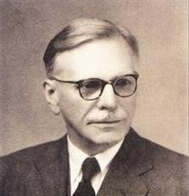
Representing words by their context
Distributional semantics: A word’s meaning is given
by the words that frequently appear close-by
“You shall know a word by the company it keeps” (J. R. Firth 1957: 11)
One of the most successful ideas of modern statistical NLP!
When a word w appears in a text, its context is the set of words that appear nearby (within a fixed-size window).
We use the many contexts of w to build up a representation of w
…government debt problems turning into | banking | crises as happened in 2009…
…saying that Europe needs unified | banking | regulation to replace the hodgepodge…
…India has just given its | banking | system a shot in the arm…
These context words will represent banking
21

Slide 19
Word vectors
We will build a dense vector for each word, chosen so that it is similar to vectors of words that appear in similar contexts, measuring similarity as the vector dot (scalar) product
0.286
0.792
−0.177
−0.107
0.109
−0.542
0.349
0.271
0.413
0.582
−0.007
0.247
0.216
−0.718
0.147
0.051
banking =
monetary =
Note: word vectors are also called (word) embeddings or (neural) word representations They are a distributed representation
‹#›

Slide 20
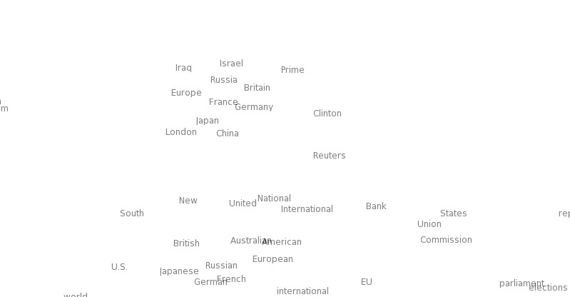
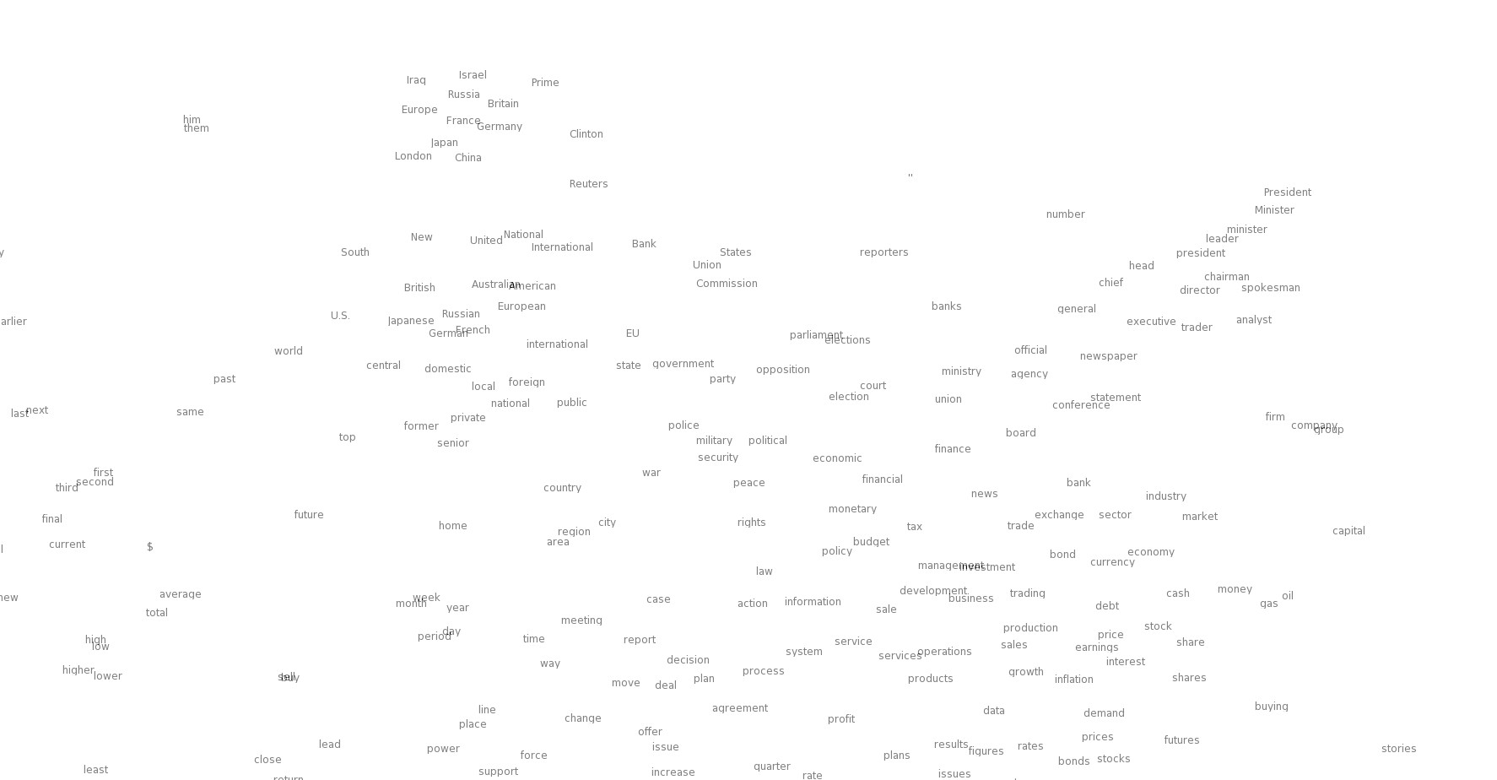

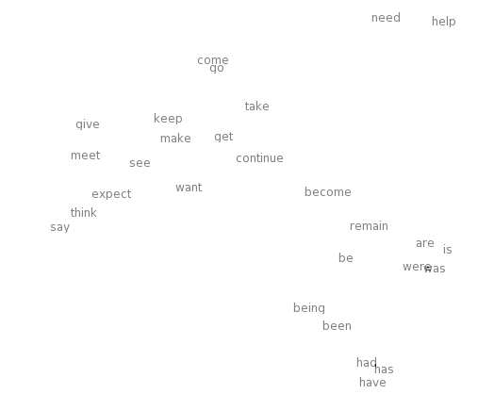
Word meaning as a neural word vector – visualization
0.286
0.792
−0.177
−0.107
0.109
−0.542
0.349
0.271
0.487
expect =
‹#›

Slide 21
3. Word2vec: Overview
Word2vec (Mikolov et al. 2013) is a framework for learning word vectors
Idea:
We have a large corpus (“body”) of text: a long list of words
Every word in a fixed vocabulary is represented by a vector
Go through each position t in the text, which has a center word c and context
(“outside”) words o
Use the similarity of the word vectors for c and o to calculate the probability of o given
c (or vice versa)
Keep adjusting the word vectors to maximize this probability
‹#›

Slide 22
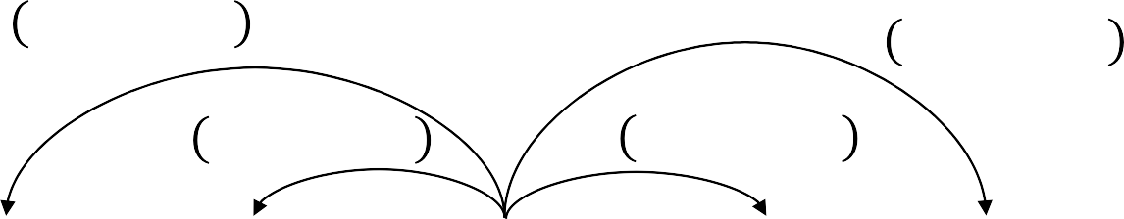
Word2Vec Overview
Example windows and process for computing 𝑃 𝑤_{𝑡+𝑗} | 𝑤_{𝑡}
𝑃 𝑤_{𝑡−2} | 𝑤_{𝑡}
𝑃 𝑤_{𝑡+2} | 𝑤_{𝑡}
𝑃 𝑤_{𝑡−1} | 𝑤_{𝑡}
𝑃 𝑤_{𝑡+1} | 𝑤_{𝑡}
…
problems
turning
into
banking
crises
as
…
outside context words in window of size 2
center word at position t
outside context words in window of size 2
‹#›

Slide 23
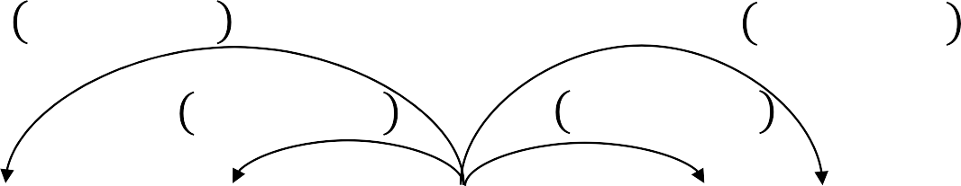
Word2Vec Overview
Example windows and process for computing 𝑃 𝑤_{𝑡+𝑗} | 𝑤_{𝑡}
𝑃 𝑤_{𝑡−2} | 𝑤_{𝑡}
𝑃 𝑤_{𝑡−1} | 𝑤_{𝑡}
𝑃 𝑤_{𝑡+2} | 𝑤_{𝑡}
𝑃 𝑤_{𝑡+1} | 𝑤_{𝑡}
…
problems
turning
into
banking
crises
as
…
outside context words in window of size 2
center word at position t
outside context words in window of size 2
‹#›

Slide 24
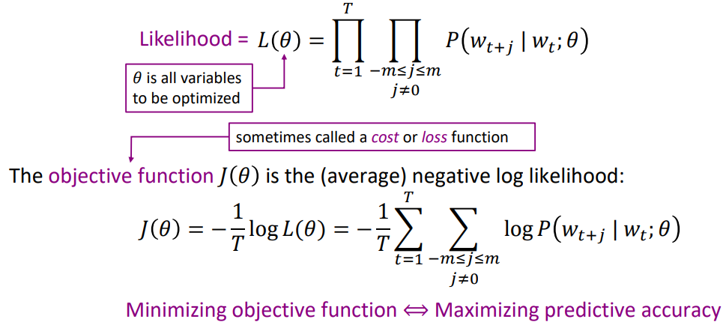
Word2vec: objective function
For each position 𝑡 = 1, … , 𝑇, predict context words within a window of fixed size m, given center word 𝑤_{𝑡}. Data likelihood:
‹#›

Slide 25
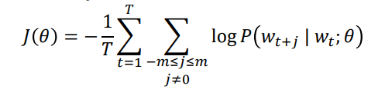
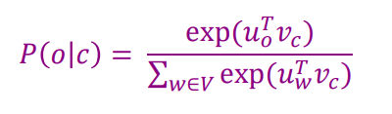
Word2vec: objective function
We want to minimize the objective function:
Question: How to calculate 𝑃 𝑤_{𝑡+𝑗} | 𝑤_{𝑡}; 𝜃 ?
Answer: We will use two vectors per word w:
𝑣_{𝑤} when w is a center word
𝑢_{𝑤} when w is a context word
Then for a center word c and a context word o:
‹#›

Slide 26
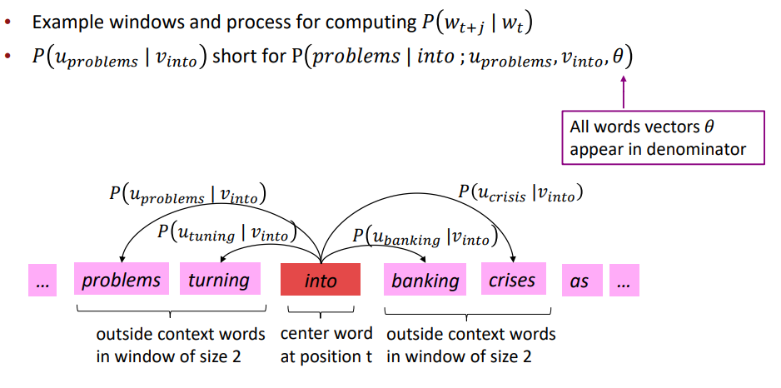
Word2Vec with Vectors
‹#›

Slide 27
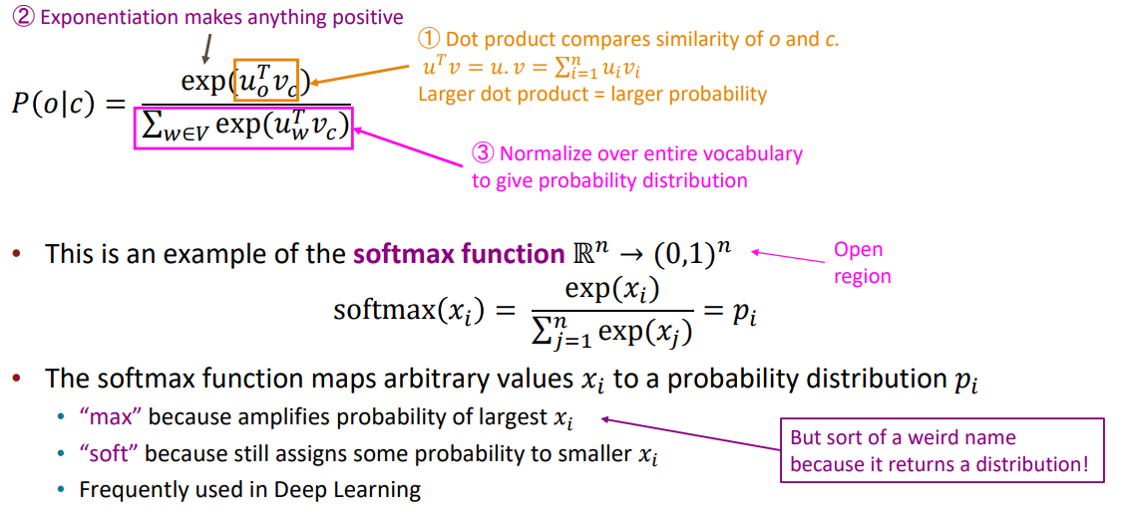
Word2vec: prediction function
‹#›

Slide 28
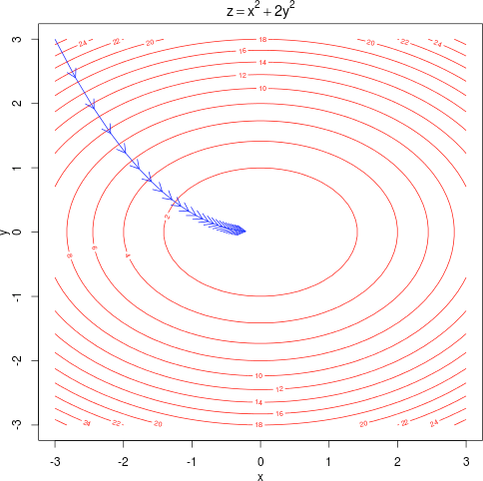
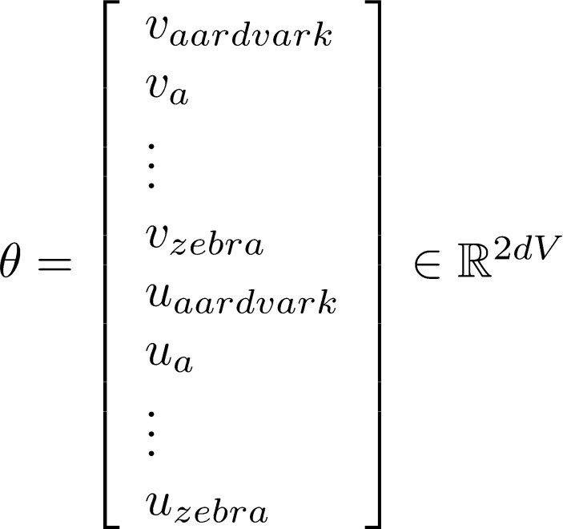
To train the model: Optimize value of parameters to minimize loss
To train a model, we gradually adjust parameters to minimize a loss
Recall: 𝜃 represents all the model parameters, in one long vector
In our case, with
d-dimensional vectors and
V-many words, we have 🡪
Remember: every word has two vectors
We optimize these parameters by walking down the gradient (see right figure)
We compute all vector gradients!
‹#›

Slide 29
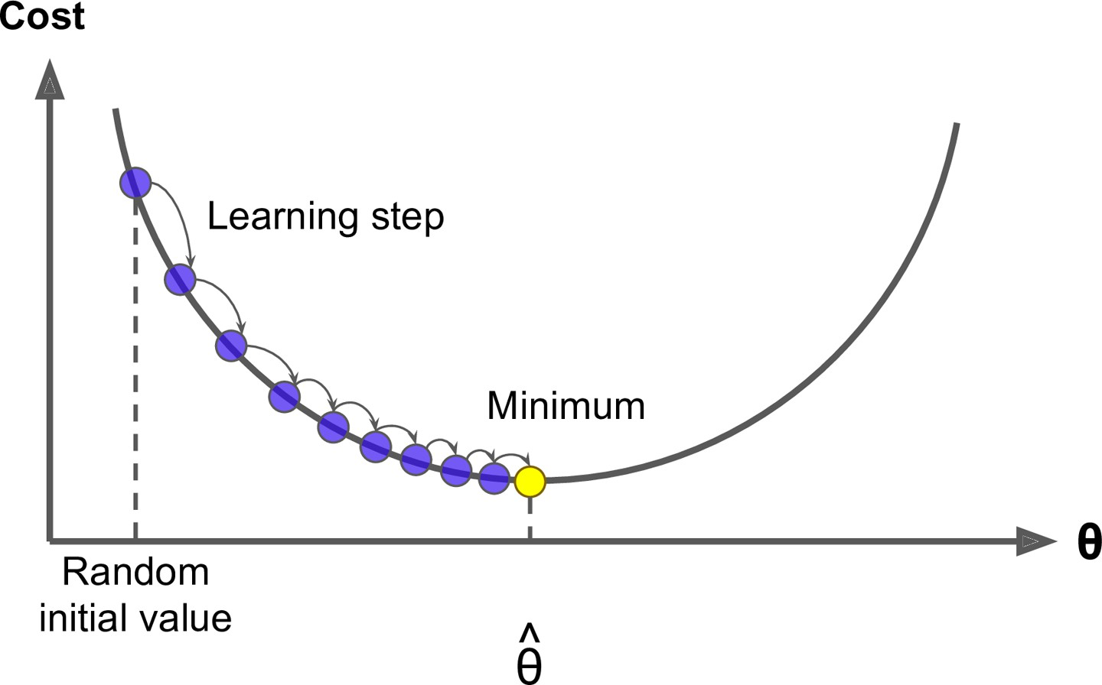
4. Optimization: Gradient Descent
We have a cost function 𝐽 𝜃 we want to minimize
Gradient Descent is an algorithm to minimize 𝐽 𝜃
Idea: for current value of 𝜃, calculate gradient of 𝐽 𝜃 , then take small step in direction of negative gradient. Repeat.
Note: Our objectives may not be convex like this ☹
But life turns out to be okay ☺
‹#›

